Slide 1
Free Code Camp Quantum Computing Course

Slide 2
Imaginary and Complex Numbers
Since x squared ever be a negative if a number squared is positive
Let I = square root of -1
Example then
  x squared = -4
  x = plus or minus square root 4 * square root of -1
  x = plus or minus 2 * square root of -1
  x = plus or minute 2i
An imaginary number contain a factor of the square root of 1 or i
Complex Numbers – Contain a real number and an imaginary number
  ex a + ib where both a and b are real numbers
  Examples: 2 + 3i -1 -i square root of 2 + ( I * square root of 3 )
Add or subtract complex numbers by coming the real parts and then the imaginary
  Ex. ( 2 + 3i ) + ( 4 – 8i ) = 6 -5i
  Ex. ( 1 + 9i ) + ( -3 - 8i ) = -2 + i

Slide 3
Imaginary and Complex Numbers
Multiplication and Division of complex number
  ( 2 + 3i ) * ( 4 – 8i ) =
    8 -16i +12i -24i^2
    8 – 4i – 24i^2 I = square root of -1 and the square is -1
    8 – 4i -24(-1)
    8 -4i + 24
    32 – 4i
Complex Conjugate of conjugate of a complex number is when you take the complex number and flip the sign or negate the imaginary part
  a + ib = ( a + ib ) * = a – ib
  Examples
    ( -2 + 3i ) * = -2 -3i
    ( 3 - I ) * = 3 + I
  Property : If we multiply any complex number by its complex conjugate it is always a read number
  Example (2 + 3i) * ( 2 – 3i)
    4 -6i + 6i -9i^2
    4 – 9i^2
    4 – 9(-1)
    4 + 9
    13

Slide 4
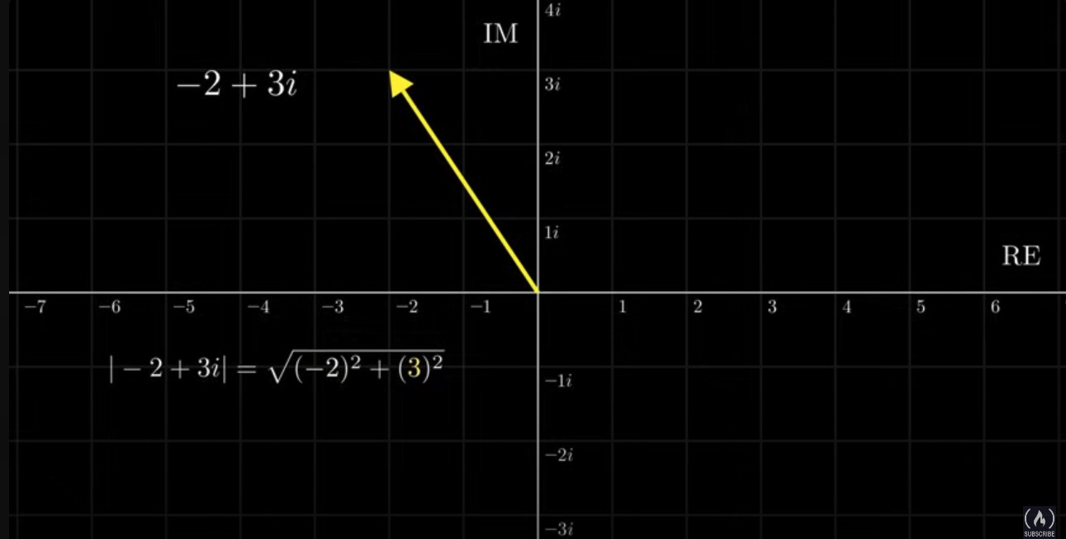

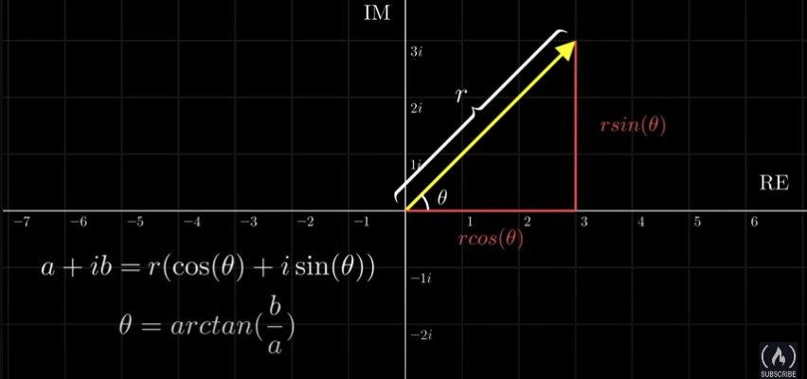
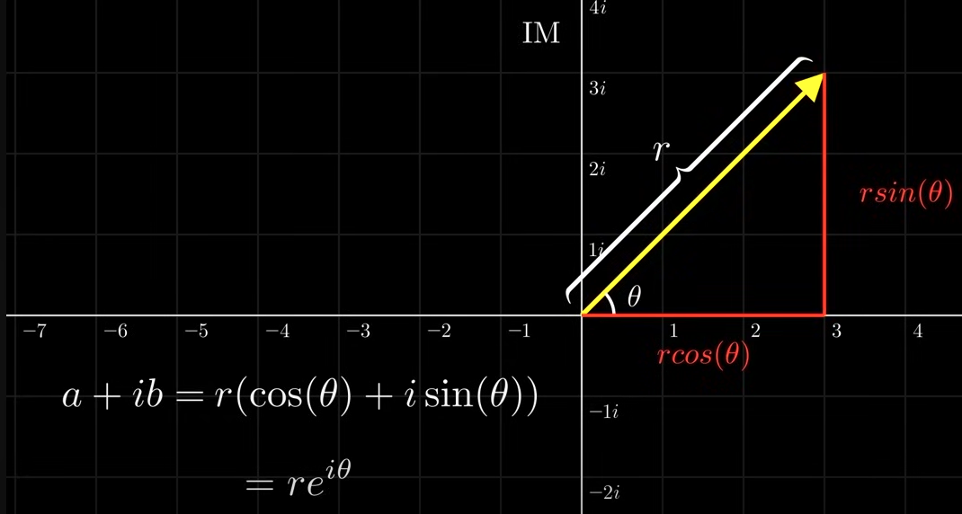
Complex Numbers in a number plane
Property of complex numbers
  magnitude
  equation
  Can also graph using the magnitude and angle ( Polar Form )
    r is the magnitude
    theta is the angle it makes with the positive axis
Convert 1 + I into polar from and exponential form
  r = square root of 2
  theta in arc tangent of 1 – 45 degrees
  square root of 2 * ( cos(45) + I * sign(45)
  square of 2 * e^i45 degrees
Usually use complex numbers in exponential form
Change theta we rotate around a circle
  multiply two complex number whose magnitude is one we are just rotating around a
  circle
    This property is very useful in representing quantum states

Slide 5



Matrixes
Unitary and Hermitian Matrices
Matrix Multiplication is not commutative
Column Vector -- ( n , 1)
  When multiplying a matrix by a column vector we get another column vector
Identity matrix * matrix = matrix
Identity matrix = Inverse Matrix * Matrix
Unitary and Hermitian Matrices
  The last symbol is a dagger
  In quantum computing we use two types of matrixes
    Unitary Matrices
      Inverse of U is U dagger
      When acting on a vector, unitary matrices rotate/flip the vector, keeping the magnitude of the vector the same
    Hermitian Matrices
      Given a hermitian Matrix H then H = H Dagger
  EigenVectors and Eigen Values
    Apply a transformation to a matrix and it stay in the same direction (stretched or shrunk )then scalar can be factored
    When this happens we call the vector an Eigenvector ( v with an arraow above ) and lambda is a scalar factored out (eigenvalue)

Slide 6

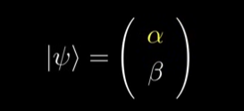
Introduction
Classical computers use 0 and 1, but Quantum computers use Qubits ( can be 0 and 1 at the same time)
Physically a qubit can be made from any quantum particle that has 2 distinct states
  For example a photon of light being polarized either horizontally or vertically
Still use 0 and 1, but define them as column as column vector
Superposition – A quantum particle is in two states at the same time
  A Qubit is in superposition if it is both |0> and |1> at the same time
Represent Qubit Mathematically
  See second image from top
  alpha – Percentage Qubit is in the |0> state
  beta – Percentage Qubit is in the |1> state
  If both the alpha and beta have value that is not 0 then it is in superposition
How do we measure Qubits
  When we measure a quantum system it collapses into the measured state
  If you have a photon that is in superposition of both vertically and horizontally when we measure it can only measure it as horizontally or vertically polarized and once it has been measured it will collapse into ( becomes ) the measured state

Slide 7
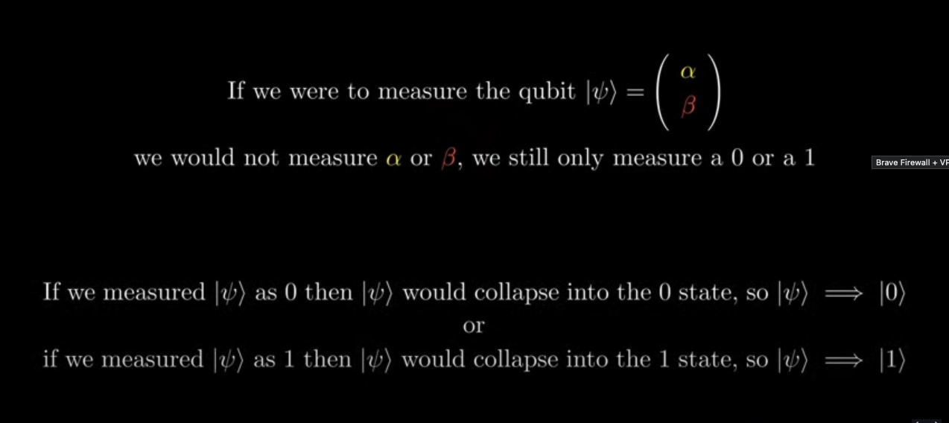
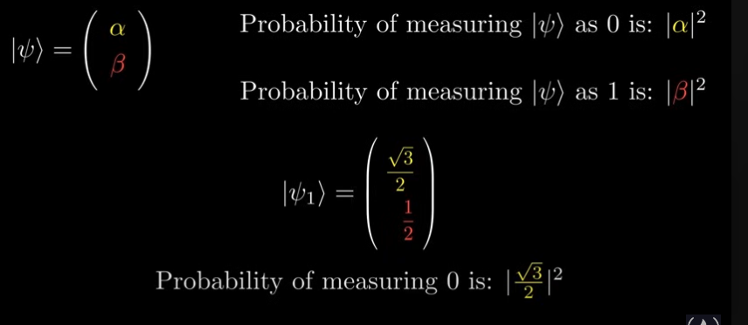
Introduction
  When we measure a Qubit it state changes to 0 or 1
  What is the point of the alpha and beta
    probability of measuring a 0 or 1
    probability is the measure by the absolute value
    of alpha or beta squared.
  In a column vector the Qubits |a| squared + |b| squared
  = 1
Once measures the Qubit collapses into a value it is always that
value

Slide 8
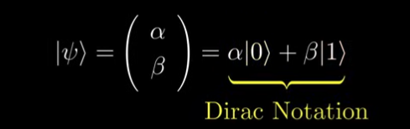
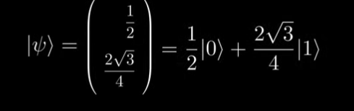
Introduction to Dirac Notation
Turn the Qubit state into Dirac Notation
Kets
  Used to represent quantum states which are vectors in complex
  vector space
    Examples |0> and |1>
Second picture is an example of converting the quantum states into Dirac
Notation
  Writing a quantum computing state
  Easy to write instead of very large matrices

Slide 9
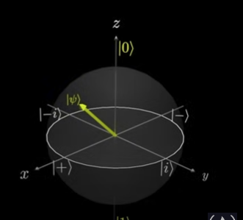
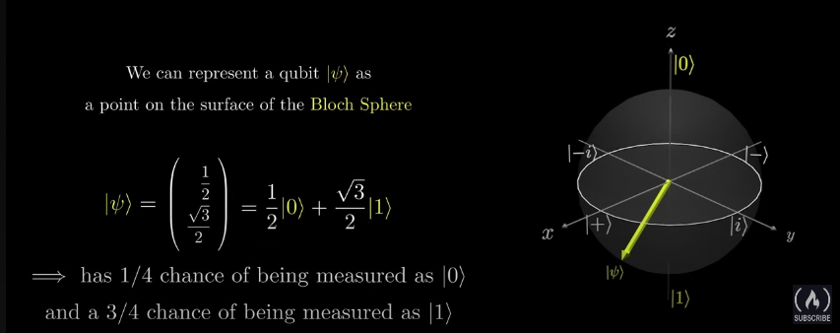
Representing a Qubit on the Block Sphere
Represent a Qubit graphically
On the top we have the 0 stare and on the bottom we have the 1 state
On the horizontal we have the -i, +i and positive and negative states
Phase the Qbit can spin around the sphere
The higher up the Qubit is the more likely we are to measure 0 and the lower the Qubit is the more
likely we are to measure 1

Slide 10
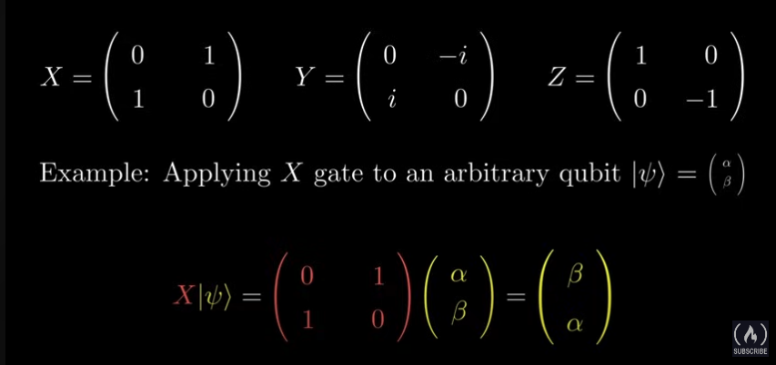
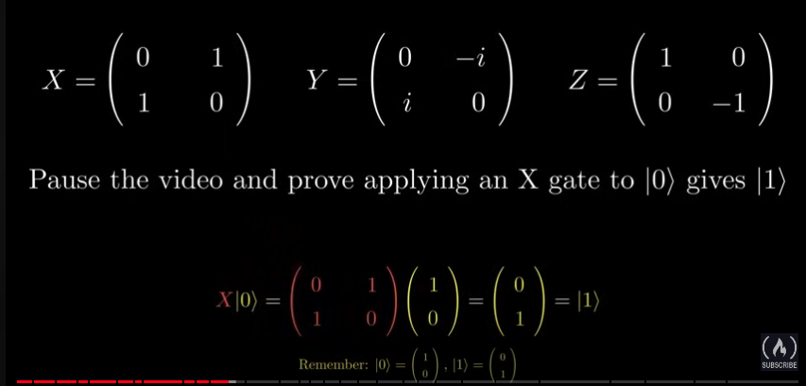
Manipulating a Qubit – The X,Y,Z Gates
X Gate
  Rotates the Qubit pie radians ( 180 degrees )
  around the X Axis on the Bloch Sphere
Y Gate
  Rotates the Qubit pie radians ( 180 degrees )
  around the Y Axis on the Block Sphere
Z Gate
  Rotates the Qubit pie radians ( 180 degrees )
  around the Z Axis on the Block Sphere
If we apply the same gate twice then the qubit will end up in its original
position
  The three gates are their own inverse

Slide 11
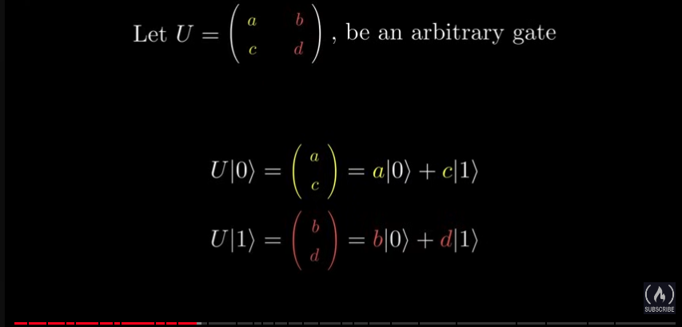
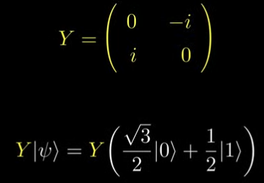



Manipulating a Qubit – The X,Y,Z Gates
For a matrix that models an arbitrary gate the first column indicate
the column vector the 0 state become after applying the gate
Quantum Gates are linear
  If an arbitrary gate is applied ( U) that gate acts on
  each of the superposition gates individually
Apply a Gate to a state
  Second Picture – Is the question apply the gate to the Qubit
  Third Picture – Column 0 of the gate goes with Bit 0
  Fourth Picture Factor out the I
  Fifth Picture – Convert back to Dirac Notation

Slide 12

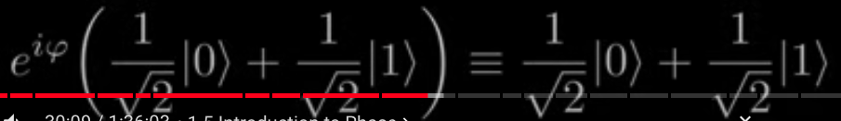
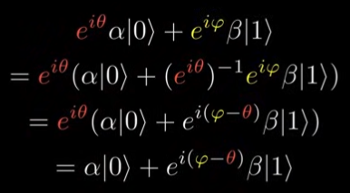
Introduction to Phase
Phase – Rotating around the X Axis
e^{i(pi/2)}
  Use complex numbers in exponential form so we can rotate around a circle by changing phi
  phi is (pi/2)
There are two type of phase
  Global Phase
    When the entire Qubit is multiplied by a complex number
    Is physically irrelevant
  Relative Phase
    When the 1 phase is multiplied by the complex number
    When the amplitude of the 1 start has the factor of a complex number
What if we have a complex number in both the 0 start and the 1 state
Phase does not affect the probability of measuring a 0 or a 1

Slide 13
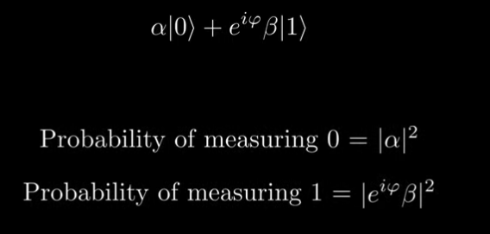

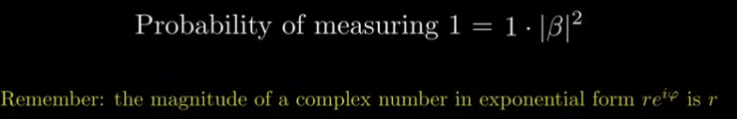
Introduction to Phase
Show that the local phase has not effect on the probability

Slide 14
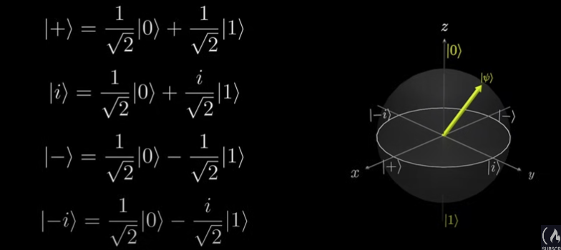
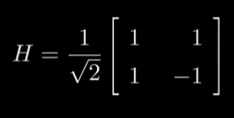
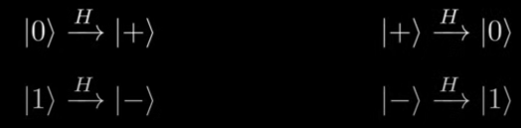
The Hadamard Gtae
On Bloch’s Sphere : +, -, +i, -i have the same probability of being
measured as 0 or 1, but each one contains a different relative phase
Hadamard Gate – See Second Picture below for matrix and the one on the
right for the conversions
The Hadamard is its own inverse

Slide 15
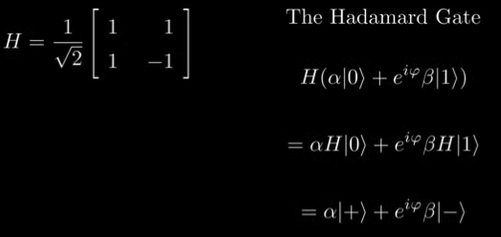
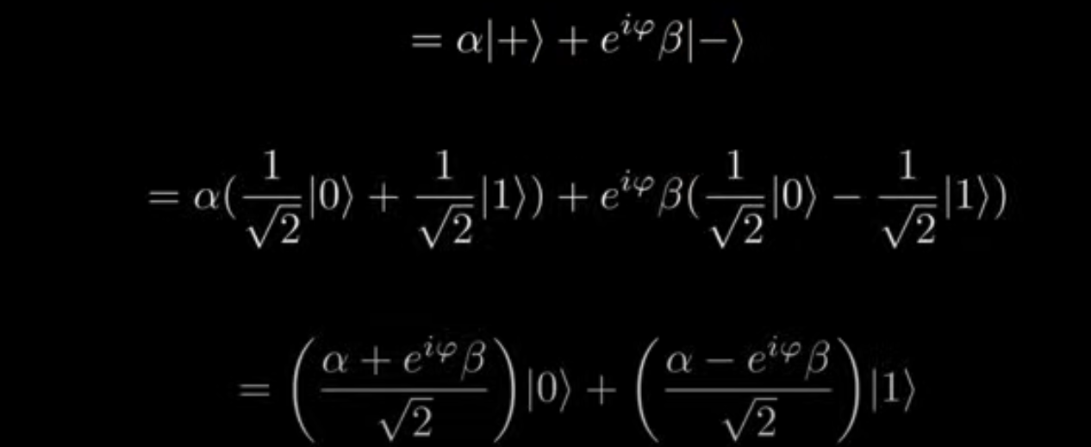
The Hadamard Gate
Apply a Hadamard Gate to an arbitrary Qubit State
Hadamard shows that phase matters
  If we apply the gate to the plus state we get a 0 and
  to the minus state we get 1.
  States only different by a phase and have a .5
  change of being 0 or 1, but the measured value is
  different

Slide 16
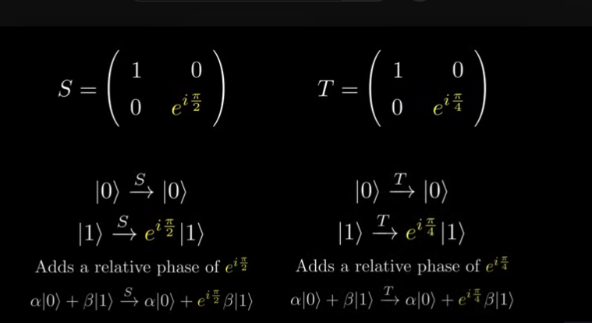
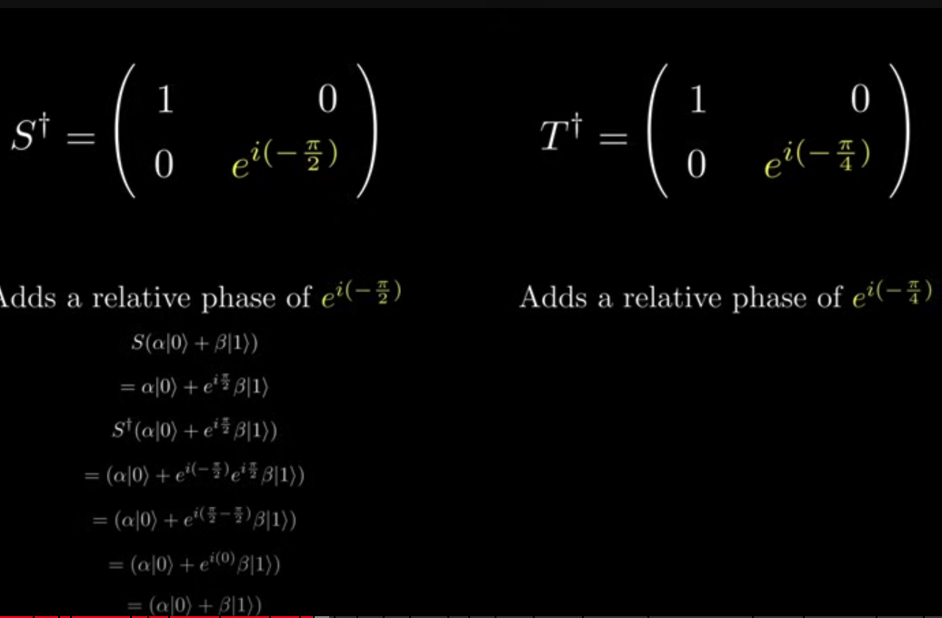
The S and T Gates
add radians
  (pie/2) and (pie/4)

Slide 17


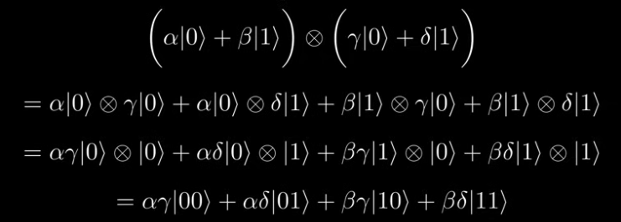
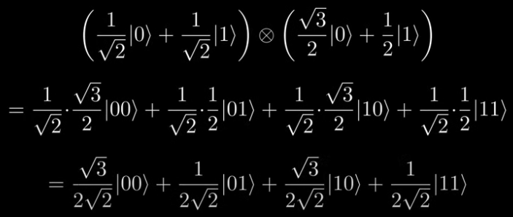
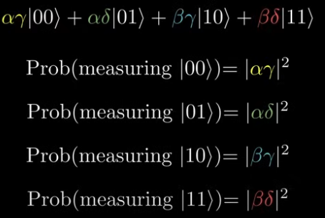
Representing Multiple Qubits Mathematically
Represent multiple Qubits through the tensor product
Two Qubits in the zero state
Represent 2 Qubits in superposition
Represent Two QuBits in supper position ( see pics 2 and 3 )
  Multiply the amplitude of the states
  We have 00, 01, 10, 11 States
  Measurement works the same as before ( See Pic3)
Below : Combing Two QuBits

Slide 18
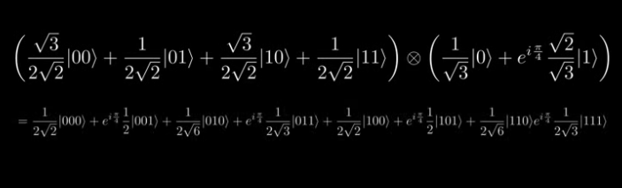
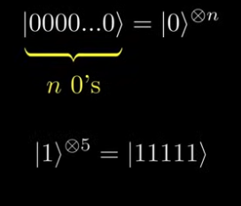
Representing Multiple Qubits Mathematically
Add another Qubit to system then tensor it to the end
Screen Shot 2 – More Dirac Notation

Slide 19
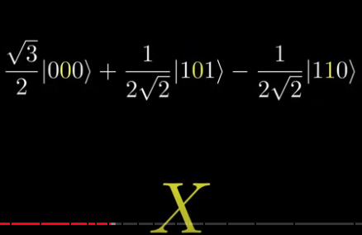

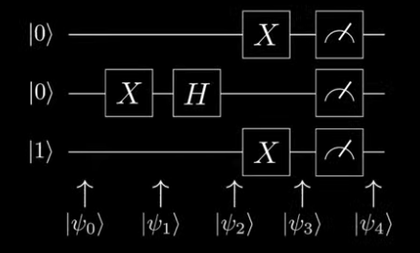
Quantum Circuits
Ex. apply a gate to a certain QuBit – Apply an X gate for the second Qbit
2nd Picture a Quantum Circuit
  Vertical – QuBits ( The states on the left are the initial states )
  Boxes – Quantum Gates
    The image directly to the right is the measurement
    Start from the left and end up on the right
  Side States – Point to different points in the circuit
    Use to represent the state of system at different points

Slide 20

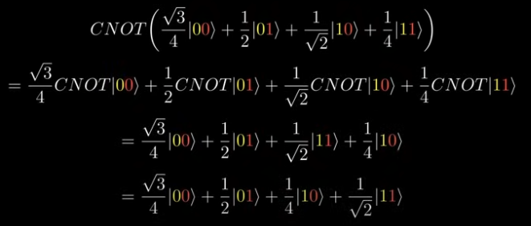
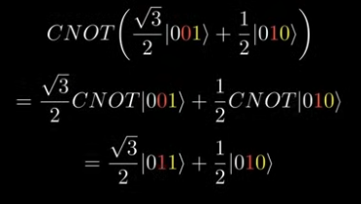
Mutli-qubit gates: CNOT, Toffoli and Controlled Gates
CNOT – Controlled X Gate
See image to the right ( symbol of CNOT)
Takes 2 inputs ( control QuBit and Target QuBit)
  The single gate applies an X Gate to the Target if a controlled QuBit is 1
  If controlled is a 0 then does nothing
Example of QuBit working Image 2 is an example
Example of QuBit working on image 3 is an example

Slide 21
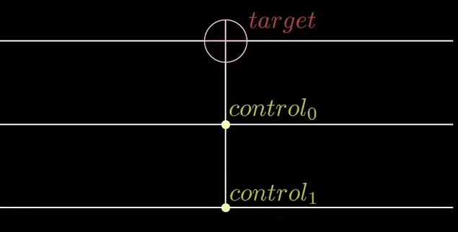
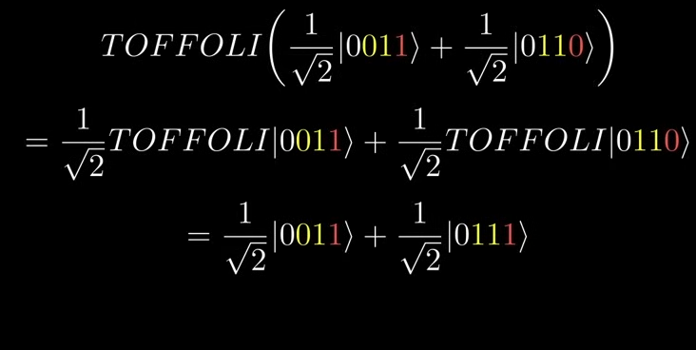

Toffoli Gate
Same as CNOT,but has two inputs
For the picture on the right 2,3 qubits are the
control
Using CNOT gates we can create controlled
versions of our single qubit gates
We also have CY, CZ, CS, CT, CH
  Apply the control
  If control = 1 does something the target becomes 1
  If control = 0 does something the target becomes 0
Example of the CS Gate is the third picture

Slide 22

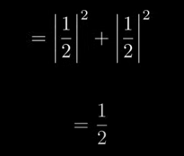
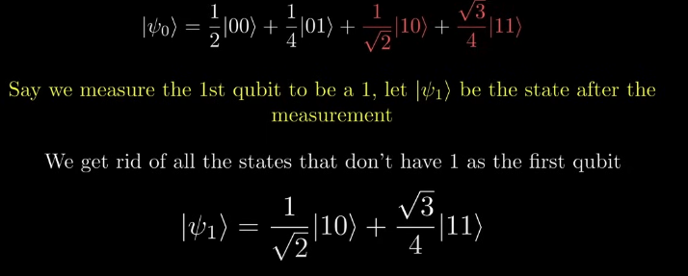

With Multiple Qbits how do we measure a single QBit
Want find the probability of measuring the second QuBit as 1
Prob(measuring the second qubit as 1) =
Prob(measuring |01>) +
Prob(measuring |11>)
How do we know what the state collapses to once it is a Qbit ?
  Looking at the third and fourth picture.
  The probability no longer adds up to one. For the last
  line of the picture
  Fix : Add a normalization constant
    For last equation apply A
Can use this technique with any number of QuBit

Slide 23
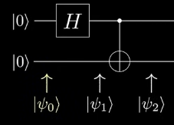






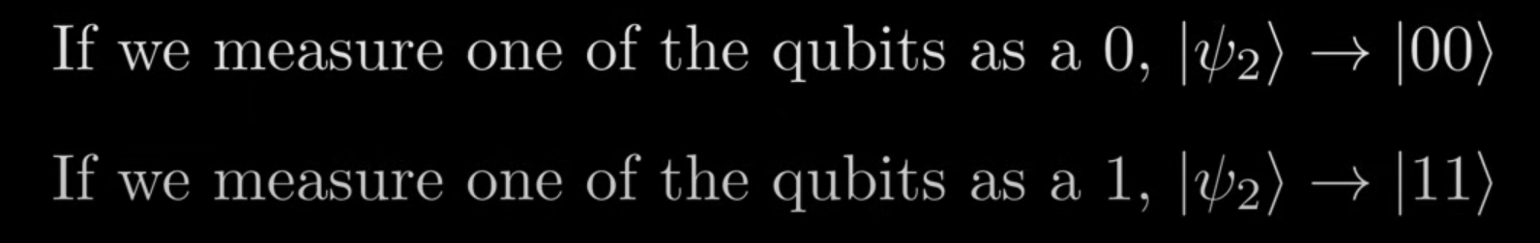
Entanglement and the Bell States
Staring is picture 2, Example of H-Gate (pictures 3 and 4 ), Example C-Not ( picture 4 and 5 on same line )
Pictures 7 and 8 – By measuring one of them ( Since Each QuBit has the same numbers ) -- Entanglement
  A state is entangled if it cannot be factored into the tensor product of individual states
  When QuBits are entangled they depend on each other to determine their state

Slide 24

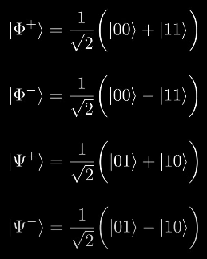
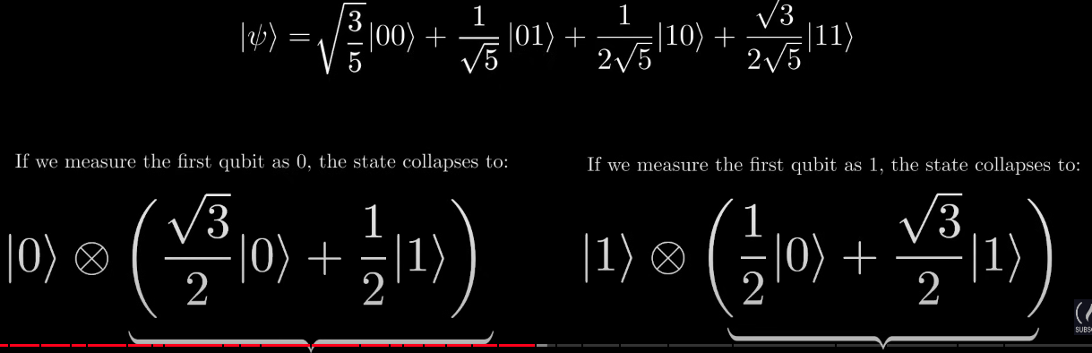
Entanglement and the Bell States
1st Picture : Example is Non Entangled
Entangled
2 Types of entangled states
  QuBits are maximally entangled if by measuring one of the qubits we can determine with certainity if the other qubits will be measured as 0 or 1
  Picture to right of commonly entangled states with 2 QuBits. Picture on right
    Called the Bell States and note with Phi and Sti
  Partially entangled if by measuring one of the qubits the amplitudes of the other qubits are affected

Slide 25
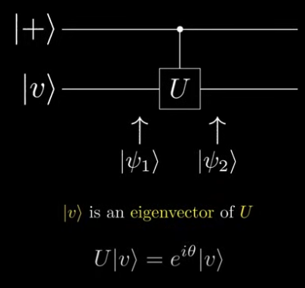






Phase KickBack
All eigen values can be represent as
all eigen values can be represented as
e to the i theta
We have a Control UGATE
V is unchanged even through it was the target
QuBit

Slide 26
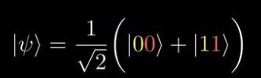
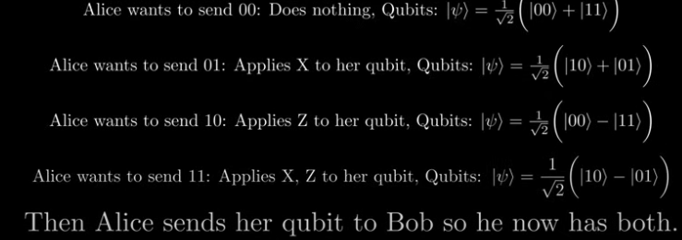
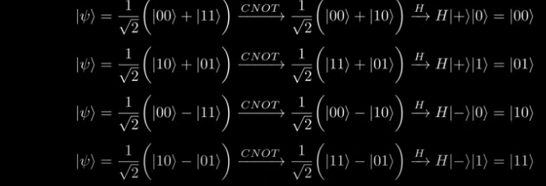
SuperDense Coding
Quantum protocol that allow use to send two bits of
classical information ( 00,01,10,11) using 1 Qubit
  We need entanglement and Alice is sending
  and the person receiving is bob
  Alice and Bob entangle two QuBits and are in this state
  When Alice wants to send two QuBits of information to bob she
  performs
  Now Bob has both the Qubits and applies the first Cbit as control
  and the second as the target and apply a Haddamod Gate
    See Last picture
  When we measure them we get the two QuBits Alice intended to
  send

